Slide 1
Cycle Two
Presentation
By:
Trevor Aupperle
Benjamin Fisk
Camden Davis
Mohab Yousef

Slide 2
Cycle Two Overview - Ben
For this cycle, our team focused on redesigning the user interface of the application, as the old interface looked very outdated and was unintuitive for users. The new design fits in with other applications that many users will have experience with, which will make using the application easier. We also spent time exploring solutions to the driver routing problem, and deciding on ways to implement the new rating feature.

Slide 3
Technical Challenges - Ben
Some of our team have had issues using the macs in the Senior Design lab, as a result of permission and storage constraints.
Creating routes for drivers that do not use roads with speed limits above a certain threshold is proving difficult, as Google does not provide an API for this purpose

Slide 4
System Metaphor - Mohab
Similar to a digital golf caddy guiding players through the course, this app acts as a digital gameday caddy. On football game days, it serves as a personal navigator through the campus. Allows users to easily request rides from nearby golf carts, ensuring easy travel to desired locations.
Utilizes a friendly and intuitive interface.
Establishes a quick, efficient, and hassle-free environment for fans on game days.

Slide 5
Cycle Intent - Camden
We finished creating prototypes for the modern user interface, and have begun working on the same developments for the driver side of the application.
We have explored options for solving the problem of the Google Maps API not including speed limits.
We have Implemented a system for riders to see their past ride history.
We have begun connecting the application to the database.

Slide 6
User Story - Flutter Migration - Trevor
Summary: As a user, I need to be able to use the app to work as intended with no security flaws.
Description: The current Flutter version used in the application from previous teams is Flutter 1.22.5. This is a major concern since Flutter has since released 2 major version updates which include null-safety checking, sunsetting of old iOS versions (iOS 9 and iOS 10), and performance/security improvements. All of these are necessary to ensure the application works as intended and improves the security vulnerability risks.
Status: COMPLETE

Slide 7
User Story - OS-Check - Trevor
Summary: As a user, I need to be able to use the app on the most recent versions of iOS and Android operating systems.
Description: After migrating to Flutter 3.0, we need to ensure we can run the app on simulators for different operating systems.
Status: COMPLETE

Slide 8
User Story - Login via Facebook - Trevor
Summary: As a user, I need to be able to login to the app using my Facebook profile.
Description: The Flutter package, flutter_facebook_login, is no longer compatible with Flutter 3.0 and has not been updated in over 4 years. We need to find a new package that is capable of handling facebook sign-ins (we should probably use firebase_ui_oauth_facebook since it is specifically used in conjunction with Firebase and is built by Google).
Status: Not Started

Slide 9
User Story - Firebase Communication - Trevor
Summary: As a user, I need the application to be able to communicate with a database to store and process data and requests.
Description: The current geoflutterfire package is incompatible with newer versions of Firebase packages. We need to migrate to the more updated geoflutterfire2 package to handle the dependency issues.
Status: IN PROGRESS

Slide 10
User Story - Alternative To Unicorndial Package - Trevor
Summary: As a user, I need an intuitive and friendly user interface to interact with.
Description:
There is a Flutter package, unicorndial, that is currently being used as a user interface component. However, it has not been updated in 5 years and no longer works with the new Flutter version. We need to find an alternative or build our own component.
Status: Not Started

Slide 11
User Story - Stripe Update - Trevor
Summary: As a user, I need a reliable purchasing system to make purchases on the app for the rides I request.
Description: Currently, the app uses the package stripe_payment to handle payments with the payment provider Stripe. Stripe has migrated to a newly updated package flutter_stripe. Changes need to be made in the app to handle the new package.
Status: COMPLETE

Slide 12
User Story - Location Package Update - Trevor
Summary: As a user, I need the app to request to use my location.
Description: Currently, the app uses the package Geolocator to handle getting the user’s location. The old package is poorly implemented and out of date. Either the current package needs to be updated, or changes need to be made in the app to accommodate a new package.
Status: COMPLETE

Slide 13
User Story - Figma Mockups - Trevor
Summary: As a user, I need an intuitive and friendly interface to interact with.
Description: Currently, the user interface for the app is simply bad. We need to draw up high-fidelity prototypes in Figma to create a better UI/UX system for users.
Status: IN PROGRESS

Slide 14
User Story - Implement UI Changes - Trevor
Summary: As a user, I need an intuitive and friendly interface to interact with.
Description: After mocking up prototypes in Figma and getting them approved by the sponsor, we need to implement the features in the code.
Status: IN PROGRESS

Slide 15
User Story - Driver Directions Research - Trevor
Summary: As a user (driver), I need to be able to see the best route to take customers to their desired destination.
Description: We need to limit driver routes to streets that can accommodate golf carts legally (35 MPH or less) and also be able to show routes that will likely be “blocked” on game days for vehicles. We will have credentials to get through “blocked” roads. Need to take into account cost algorithms when researching. Complete research of how we can accomplish this.
Status: IN PROGRESS

Slide 16
User Story - Driver Directions Research Impl. - Trevor
Summary: As a user (driver), I need to be able to see the best route to take customers to their desired destination.
Description: We need to limit driver routes to streets that can accommodate golf carts legally (35 MPH or less) and also be able to show routes that will likely be “blocked” on game days for vehicles. We will have credentials to get through “blocked” roads. Need to take into account cost algorithms when researching. Implementation of research conclusions from parent user story.
Status: Not Started

Slide 17
User Story - Rider ‘On the Way’ Notification - Trevor
Summary: As a user, I would like a notification about when my driver is going to arrive.
Description: Add a notification for the rider when the driver is on the way to pick them up with an estimated arrival time. Riders should see where the driver is while they are en route.
Status: Not Started

Slide 18
User Story - Rider Status - Trevor
Summary: As a user (rider), I would like to be able to see where I am at in my ride on a map as the drive is occurring.
Description: Once a ride has begun, the rider should see the golf cart location on a map as it moves along the drive.
Status: Not Started

Slide 19
User Story - Rider Recap Screen - Trevor
Summary: As a user (rider), I would like to see a recap of the ride I just took.
Description: Once a ride is over, a screen should be shown to the rider that summarizes their trip and costs. It should also prompt the user for a rating.
Status: IN PROGRESS

Slide 20
User Story - Drivers Near Me - Trevor
Summary: As a user (rider), I would like to see where the nearest drivers are around my current location.
Description: Riders should be able to see current locations of carts around them on a map.
Status: Not Started

Slide 21
User Story - Feedback/Rating System - Trevor
Summary: As a user, I need to be able to give feedback and rate both driver and riders after interactions with them.
Description: Implement a 5-Star rating system.
Status: IN PROGRESS

Slide 22
User Story - Enhance Feedback and Tip Screen - Trevor
Summary: As a user, I need a streamlined and engaging interface for feedback and tips.
Description: The current design doesn't have a feedback screen, which we've found to be less effective. The goal is to design, add a feedback screen and merge it with the tips screen so the rider can be able to rate and tip at the same time.
Status: IN PROGRESS

Slide 23
User Story - Display Past Trips - Trevor
Summary: As a user, I would like to be able to see all of my previous trips as both a rider and a driver.
Description: Create a drivers past trips log and a riders past trips log.
Status: IN PROGRESS

Slide 24
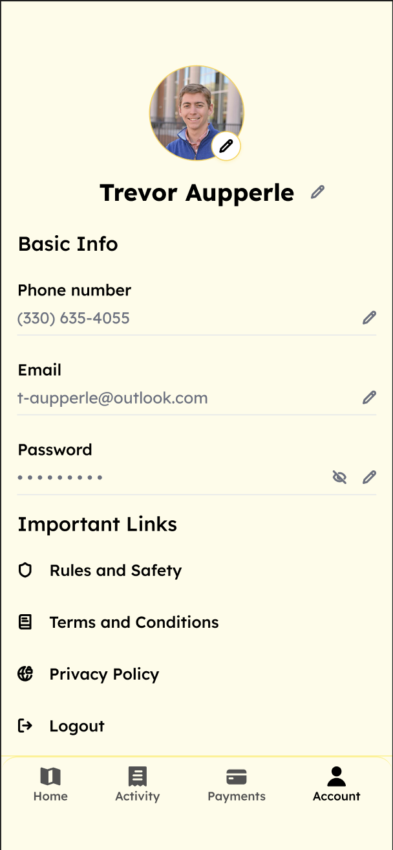
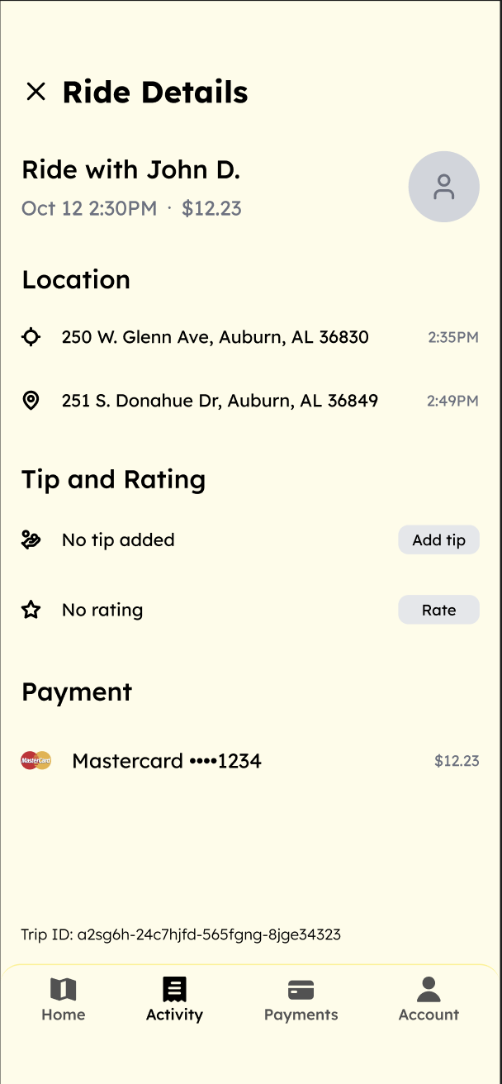
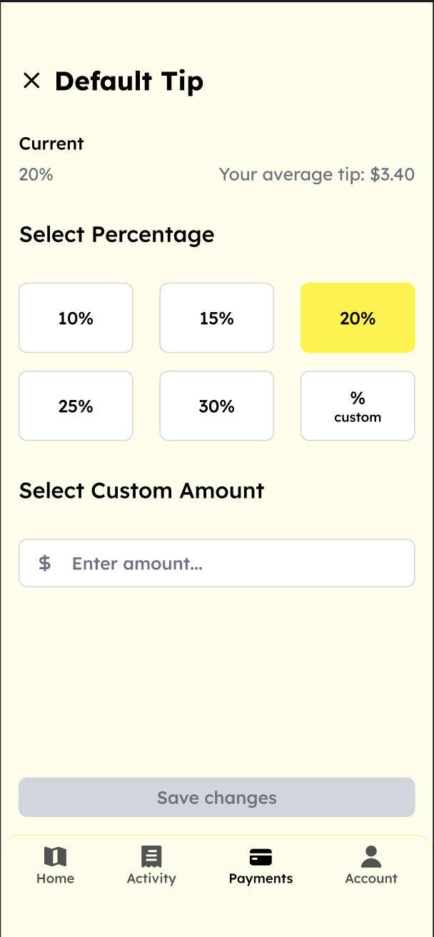
Design Documentation - Trevor
We continued to update the user interface designs. Updating the profile, default tip, and payment screens.
We also added new designs for the rider recap, activity, tip and ratings screens.

Slide 25
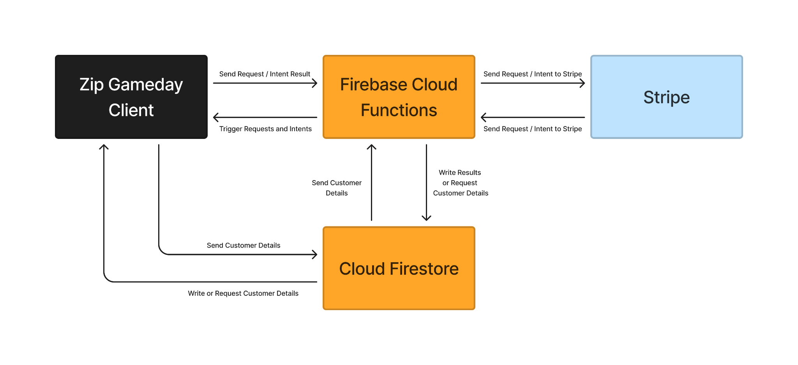
Design Documentation - Trevor
We are using Flutter as the main framework, Google Firebase and Cloud Firestore for the database, authentication and cloud services, and Stripe for payment transactions

Slide 26
Process - Camden
We will be using Jira as as project board to keep the project and tasks organized
We will be updating the app progress with our sponsor frequently
We will stay in contact with the blue team providing regular updates on our progress to avoid task overlap and ensure seamless integration between our teams

Slide 27
Test Results - Ben
The application's location features are functioning as expected on Android and IOS devices
The application’s user interface changes for the rider side have been tested successfully
The user authentication and switch to driver elements have been explored, with some further testing remaining

Slide 28
Management Plan - Mohab
In the coming cycle, we plan to:
Finalize designs for the rider side of the application and the user interface
Implement the driver side user interface changes
Connect the application with the existing database
Implement notifications for riders
Create the driver directions system

Slide 29
Demo - Trevor
The entire rider interface has been implemented
The user can log in and out as they please
The user can see their past rides and their saved payment methods

Slide 30
Risk Mitigation - Mohab
Maintaining high levels of communication within our own team and between the orange and blue teams is crucial to ensure that tasks are not duplicated and that all elements of the application align seamlessly
Regularly update and secure all project technologies.
Prioritize user login information, profile data, and payment authentication.
Implement strong security protocols to safeguard user trust.

Slide 31
Lessons Learned - Mohab
Effective communication is important
Updated infrastructure before adding development
Make better documentation as we develop

Slide 32
Future Plans - Camden
Our long term plan for the coming few cycles is as follows:
Enable precise navigation for golf cart drivers through Google Maps.
Ensure optimal route planning for efficient transportation.
Provide users with real-time notifications and updates within the in-app map.
Enhance the user experience by keeping them informed throughout the ride.
Implement a comprehensive record system for both drivers and riders.

